Slide 1

Native American Juvenile Justice Population
Heather La Forme-Maldonado

Slide 2
Native American Services

Slide 3
Native American Services
History
NYS Department of Social Welfare, July 1, 1924, Section 39 – Created Indian Affairs.
The office’s broad and general responsibilities for Native American Services are found in Section 39. “Indian Affairs” of New York State Social Services Law enacted in 1924 conferred upon the office most of the state’s responsibilities with respect to Native Americans.
Historically, staff determined service eligibility for each Native American, as well as bore responsibility for health clinics, reservation schools and transportation needs. The commissioner was regarded as the “guardian of Native Americans” since they were considered wards of the state.

Slide 4
Native American Services
Responsibilities
Serve as a liaison between state agencies and tribal groups.
Support statewide compliance of the Federal Indian Child Welfare Act (ICWA).
Mediation with local social services districts over ICWA.
Information and consultation to both public and private agencies, educational institutes and individuals.
Payment of annuities and related obligations to the state’s various Indian nations.
Providing technical assistance on issues which may be before courts.
Helping obtain tribal identity and supporting the importance of cultural identity for Native American children in foster care.
Supervision and maintenance of the Tonawanda Indian Community House (TICH).

Slide 5
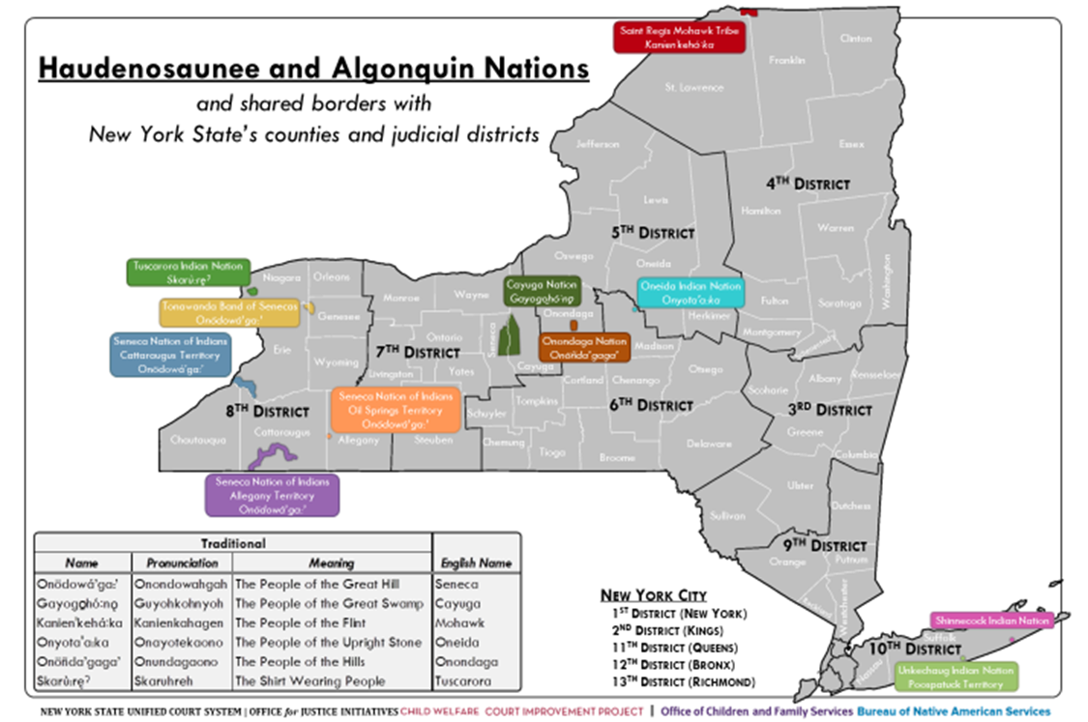
New York States Native American Territories

Slide 6
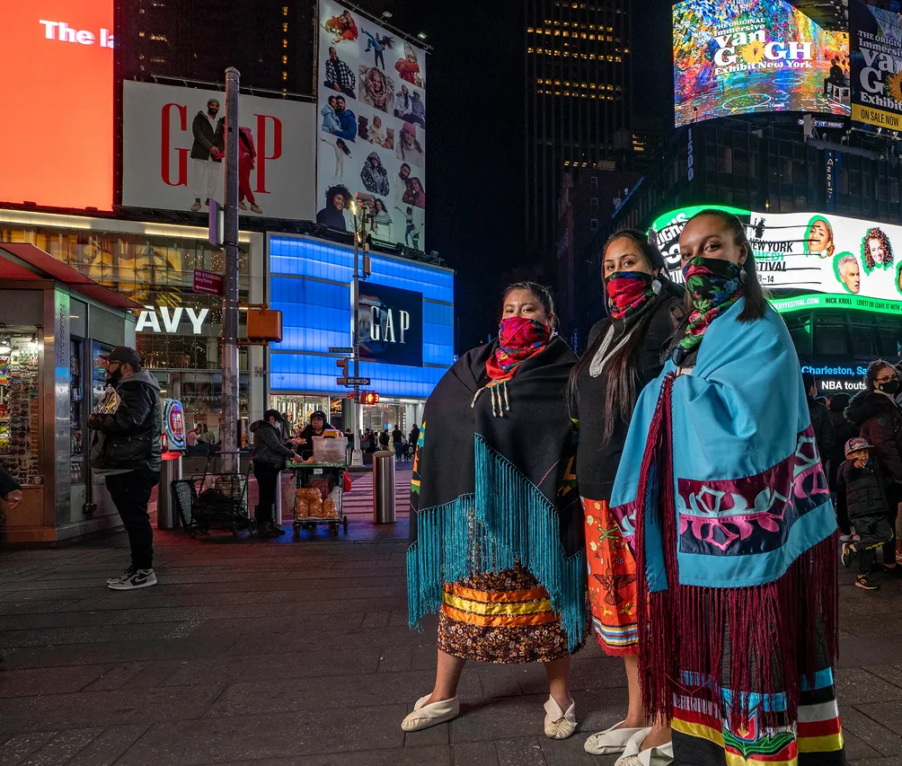
Native American Services
Facts
There are nine recognized Native American nations/tribes in New York State and 574 federally and almost 600 state recognized tribes in the United States.
The majority of Native Americans living in New York State do not reside on reservations. They live in rural areas as well as large urban centers, with an estimated (in 2020 Census) 86,218 living in New York City.
Notes:
Picture: https://www.huffpost.com/entry/lenape-people-lenapehoking_n_628e542ee4b0cda85db9420c

Slide 7
New York Native American Population
Data from the 2020 US Census
20,201,249 Total Population
149,690 identify as American Indian alone
153,525 identify as American Indian in combination with one other race
  113,950 – American Indian and White
  33,617 – American Indian and some other race
  5,958 – American Indian and Asian
  1.5% of the New York State Population
Notes:
https://data.census.gov/table/DECENNIALCD1182020.P8?g=040XX00US36

Slide 8
Native American Juvenile Justice

Slide 9
Economic Inequities
In 2022, near­ly one-third (29%) of AI/AN chil­dren were liv­ing in pover­ty, almost dou­ble the nation­al rate of 16%. The AI/AN child pover­ty rate has remained well above the nation­al lev­el for decades.
AI/AN kids are near­ly three times as like­ly to live in high-pover­ty neigh­bor­hoods com­pared to their coun­ter­parts: 22% vs. 8%, accord­ing to 2017–2021 data. This trend has held since the KIDS COUNT Data Cen­ter began track­ing this mea­sure in 2006–2010.
Just under half (43%) of AI/AN chil­dren live in fam­i­lies where par­ents do not have secure, full-time employ­ment, com­pared to 29% on aver­age in 2021.
About 1 in 8 AI/AN teens ages 16–19 (12%) were not in school or work­ing in 2021, out­pac­ing the nation­wide rate of 7%.
While the medi­an income for AI/AN fam­i­lies with chil­dren has steadi­ly increased over the last decade, it remains far below the aver­age fam­i­ly income, and the gap has widened in recent years, reach­ing $53,900 vs. $84,200, respec­tive­ly, in 2021.
Notes:
https://www.aecf.org/blog/native-childrens-health-and-well-being

Slide 10
Education Inequities
In 2022, about half (49%) of AI/AN fourth-grade stu­dents were con­sid­ered chron­i­cal­ly absent from school in the pre­vi­ous month, an alarm­ing jump from 31% in 2019, and well above the nation­al aver­age of 36% in 2022. For two decades, AI/AN fourth-graders have been more like­ly than their peers in oth­er racial or eth­nic groups to expe­ri­ence chron­ic absen­teeism, which can include excused absences due to health issues, trans­porta­tion prob­lems or oth­er barriers.
In 2022, more than 8 in 10 (82%) AI/AN fourth-grade stu­dents scored below pro­fi­cient in read­ing, an increase from pre­vi­ous years and a high­er share than the nation­al aver­age (68%).
Sim­i­lar­ly, close to 9 in 10 (89%) AI/AN eighth-grade stu­dents scored below pro­fi­cient in math in 2022, 10 per­cent­age points high­er than a decade ear­li­er and 15 per­cent­age points above the nation­al aver­age of 74%. Math pro­fi­cien­cy in eighth grade and read­ing pro­fi­cien­cy in fourth grade are bell­wether indi­ca­tors of long-term aca­d­e­m­ic suc­cess — includ­ing grad­u­at­ing from high school, which increas­es employ­ment and earn­ing poten­tial in adulthood.
One in 4 (25%) AI/AN high school stu­dents is not grad­u­at­ing on time. This is high­er than the nation­al rate (14%) and that of all oth­er racial and eth­nic groups with data, accord­ing to 2019–2020 data.
Notes:
https://www.aecf.org/blog/native-childrens-health-and-well-being

Slide 11
Health and Mental Health Inequities
AI/AN kids ages 0–18 are more than twice as like­ly to lack health insur­ance than oth­er chil­dren (11% vs. 5% in 2022), although the rate of unin­sured AI/AN kids improved by three per­cent­age points com­pared with 2019.
The death rate for AI/AN chil­dren and youth ages 1 to 19 from all caus­es has remained above the U.S. rate since it has been tracked on the KIDS COUNT Data Cen­ter. In 2021, the rate was 33 vs. 30 per 100,000, respectively.
Accord­ing to the CDC’s 2021 Youth Risk Behav­ior Sur­vey, AI/AN high school stu­dents are more like­ly to seri­ous­ly con­sid­er attempt­ing sui­cide than oth­er stu­dents: 27% vs. 22%. Trag­i­cal­ly, they are also more like­ly to attempt sui­cide, with 16% of AI/AN stu­dents report­ing at least one sui­cide attempt in the pre­vi­ous year, com­pared to 10% of all high school stu­dents. AI/AN stu­dents were the most like­ly of any racial and eth­nic group with data& to report seri­ous­ly con­sid­er­ing or attempt­ing sui­cide in 2021.
A 2023 Nation­al Acad­e­mies of Sci­ences, Engi­neer­ing, and Med­i­cine report found that AI/AN pop­u­la­tions expe­ri­ence sad­ness, anx­i­ety, anger and shame relat­ed to the trau­mas they have faced — includ­ing forced migra­tion, bro­ken treaties and loss of land, fam­i­ly ties, lan­guage and cul­ture. The report also called for more data on AI/AN well-being and rec­om­mend­ed mak­ing this a fed­er­al priority.
Notes:
https://www.aecf.org/blog/native-childrens-health-and-well-being

Slide 12
Family and Community Inequities
Over one-third (37%) of AI/AN chil­dren have had at least two adverse child­hood expe­ri­ences (ACEs) — more than dou­ble the nation­al aver­age (17%), accord­ing to 2020–2021 data. ACEs are poten­tial­ly trau­mat­ic events such as: expo­sure to fam­i­ly or neigh­bor­hood vio­lence, parental death or incar­cer­a­tion, fre­quent eco­nom­ic hard­ship or liv­ing with some­one who has men­tal ill­ness or sub­stance abuse prob­lems. Stud­ies have doc­u­ment­ed con­nec­tions between col­o­niza­tion, trau­ma and ACEs, with inter­gen­er­a­tional effects.
AI/AN chil­dren con­tin­ue to be over­rep­re­sent­ed in the fos­ter care sys­tem. In 2021 and pre­vi­ous years, AI/AN kids made up 2% of those in fos­ter care — dou­ble the share of the gen­er­al child pop­u­la­tion (1%). Even after the Indi­an Child Wel­fare Act was passed to pro­vide min­i­mum fed­er­al pro­tec­tions and end the forcible removal of chil­dren from their homes, the law has not been imple­ment­ed con­sis­tent­ly, and the child wel­fare sys­tem con­tin­ues to demon­strate sys­temic bias. AI/AN chil­dren remain more like­ly than their white peers to expe­ri­ence mal­treat­ment inves­ti­ga­tions and be placed in fos­ter care.
Among AI/AN youth tran­si­tion­ing out of fos­ter care — who also par­tic­i­pat­ed in a fol­low-up sur­vey — 43% report­ed expe­ri­enc­ing home­less­ness between ages 19 and 21, sig­nif­i­cant­ly high­er than the nation­al rate of 29%.
AI/AN youth are also dis­pro­por­tion­ate­ly detained and incar­cer­at­ed by the jus­tice sys­tem. The lat­est Nation­al Cen­ter for Juve­nile Jus­tice data show that 181 AI/AN youth per 100,000 ages 10 to 21 were resid­ing in juve­nile deten­tion in 2021, a sub­stan­tial decline from pre­vi­ous years but well above the nation­al rate of 74 per 100,000. Deten­tion for any length of time has been shown to neg­a­tive­ly affect youth, and it does not improve pub­lic safety.
Notes:
https://www.aecf.org/blog/native-childrens-health-and-well-being

Slide 13

Tribal Disparities in Youth Incarceration
As of 2021, Tribal youth were 3.7 times as likely to be detained or committed in juvenile facilities as their white peers, according to nationwide data collected in October 2021 and recently released. This ratio is essentially unchanged from 2011.
Nationally, the youth placement rate was 74 per 100,000 in 2021. The Tribal youth placement rate was 181 per 100,000, compared to the white youth placement rate of 49 per 100,000.
Notes:
Puzzanchera, C., Sladky, T.J., and Kang, W. (2023). “Easy Access to the Census of Juveniles in Residential Placement.” Available: https://www.ojjdp.gov/ojstatbb/ezacjrp/

Slide 14
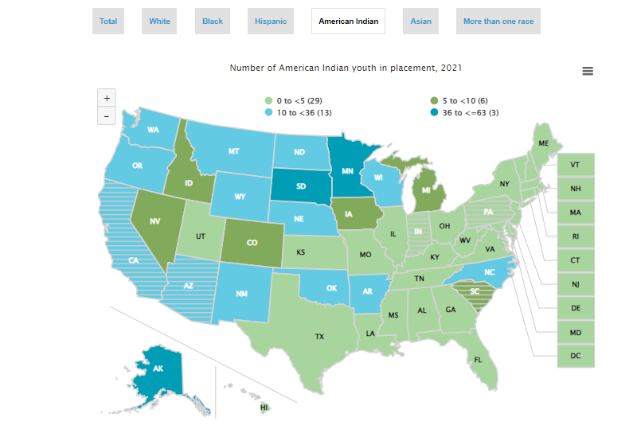
2021 Data indicates 0.
Notes:
Puzzanchera, C., Sladky, T.J., and Kang, W. (2023). “Easy Access to the Census of Juveniles in Residential Placement.” Available: https://www.ojjdp.gov/ojstatbb/ezacjrp/
https://www.ojjdp.gov/ojstatbb/ezacjrp/asp/State_Race.asp?state=57&topic=State_Race&year=2021&percent=count&maplink=link4&maps=yes&print=no
Are we really that good or are we missing something? I think we may need to double check ourselves.

Slide 15
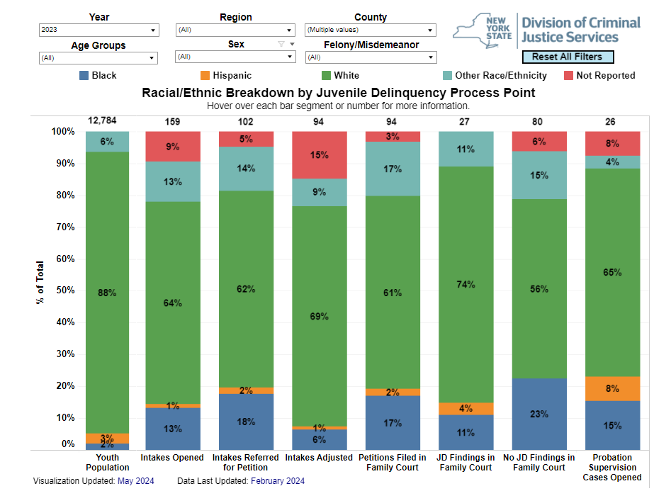
The Other Race/Ethnicity category includes cases of youth who are Asian/Pacific Islander, American Indian/Alaskan Native
Notes:
https://www.criminaljustice.ny.gov/crimnet/ojsa/tableau_rebjdpp.htm
What does the other data tell us?

Slide 16
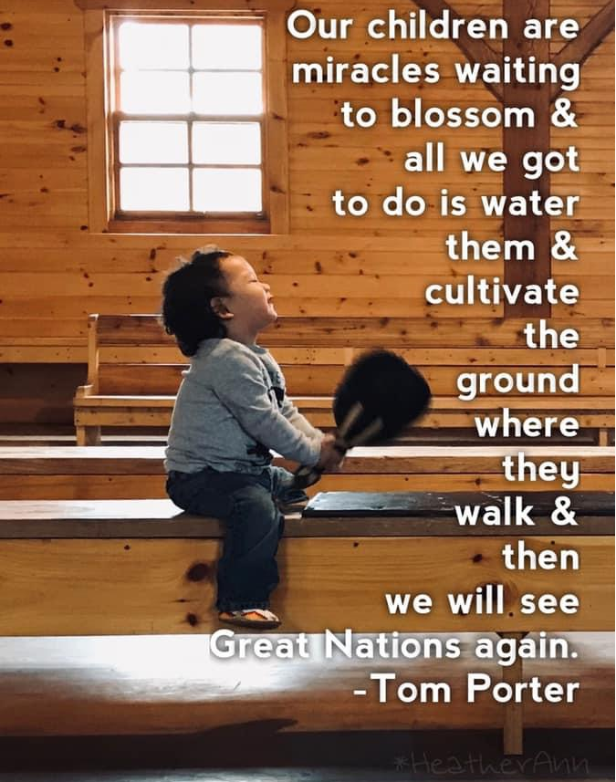
Resources
Tribal Youth Resource Center
https://www.tribalyouth.org/
Native Youth Justice Reform
https://www.indian-affairs.org/nativeyouthjustice.html
OJJDP-Culture as Prevention Webinar Series
May 11, 2023
May 28, 2024
August 29, 2023

